Slide 1
Understanding Coronary Artery Disease

Slide 2
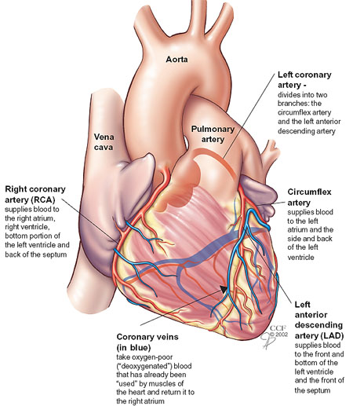
Coronary Arteries
Left Main (LM)
Left Anterior Descending (LAD) (Widow maker)
Left Circumflex (LCX)
Right Coronary Artery (RCA)

Slide 3
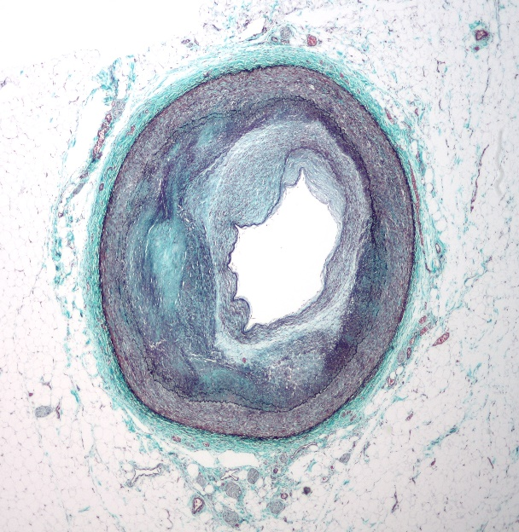
Coronary Artery Disease
What is it?
The progressive narrowing of coronary arteries by the build up of fat deposits called lesions
Coronary Artery Disease

Slide 4
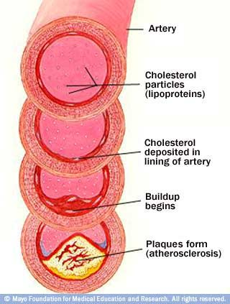
CAD & Atherosclerosis
Development
Fatty streak
Fat deposits in smooth muscle cells (yellow)
Fibrous plaque
Arterial wall begins to thicken
Fatty streak covered by collagen (gray/white)
Artery narrows, restricting blood flow
Obstructive lesion
Fibrous plaque continues to grow
Inflammation = unstable
Platelets build up into a thrombus or blood clot
Vessel becomes extremely narrow

Slide 5
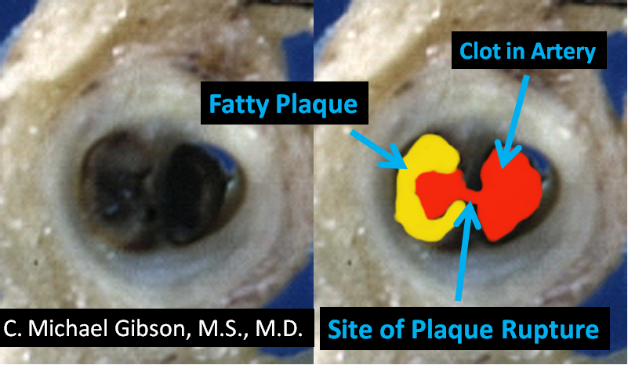
Acute Coronary Syndrome
Plaque (like a bister filled with cholesterol / dead white blood cells) in artery -ruptures
blood clot forms
Lack of blood flow to part of the heart, so that part doesn’t get enough oxygen
Damage will occur if treatment does not occur quickly
1. Unstable Angina
Partial blockage
2. Heart Attack
Complete blockage

Slide 7
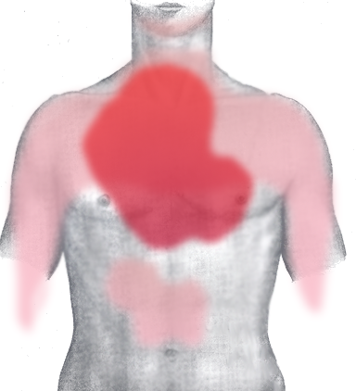
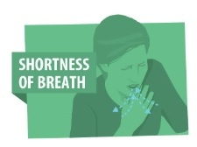
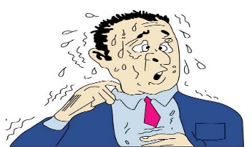
Acute Coronary Syndrome: Unstable Angina
Signs and Symptoms
Pain
stomach, neck, jaw, arms, back
Nausea or vomiting
Sweating
Shortness of breath
Emergency treatment required immediately or a heart attack will occur
Heart tissue can withstand little to no oxygen for approximately 20 minutes before cell death begins

Slide 8
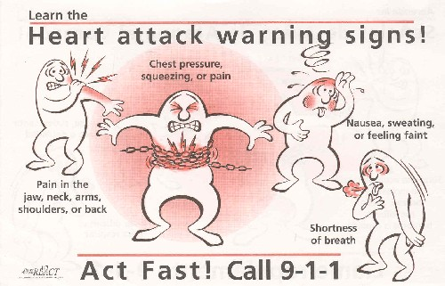
(Heart Attack)
Artery is blocked completely by blood clot and/or plaque
No blood flow = no oxygen to heart tissue
Irreversible cell death occurs and heart is damaged

Slide 9
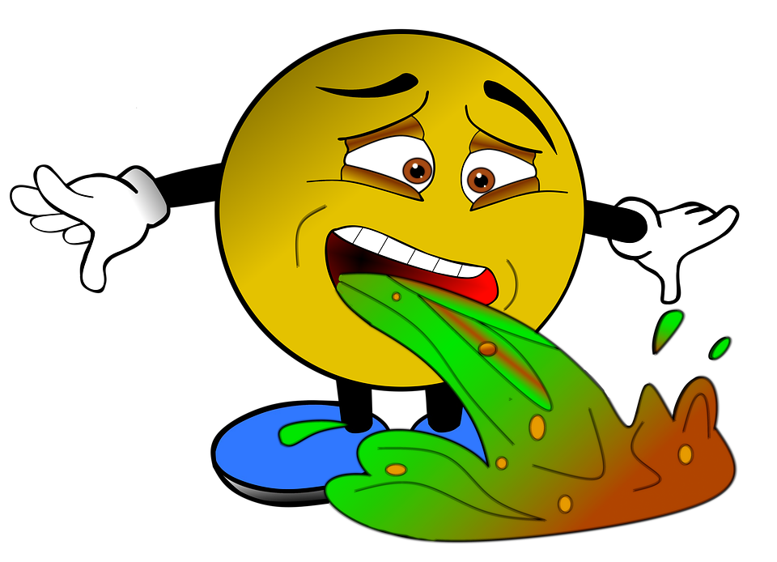
Myocardial Infarction (MI)
Signs and Symptoms of Heart Attack
Chest pain
Not relieved by rest or change in position
Crushing, burning, pressure, heaviness
Pain can radiate to the neck, back, jaw, arms
Stomach pain
Not relieved by antacid
Sweating (diaphoresis)
Nausea and/or vomiting
Fever

Slide 10
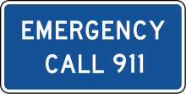
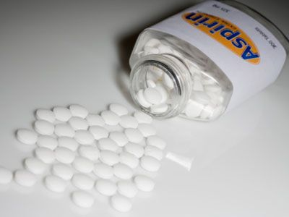
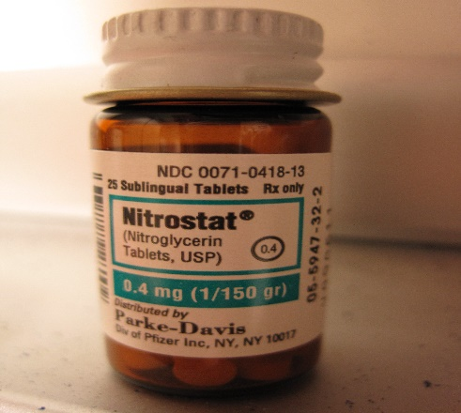
Emergency Plan
Upon onset of signs and symptoms patient should:
1. call 911 immediately
2. take 325 mg chewable aspirin
3. If prescribed, take nitroglycerin
Seek medical treatment as soon as possible to decrease damage to heart
Do not drive yourself to emergency room!

Slide 11
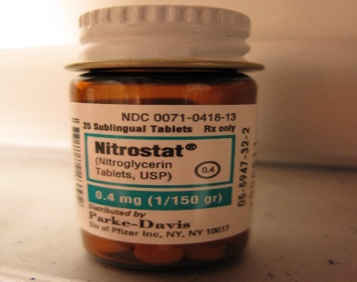
Nitroglycerine
Relieves chest pain and decreases blood pressure by vasodilating vessels
When chest pain begins
Take 1 tablet / spray under tongue every 5 minutes
Up to (3) three tablets 5 min apart
Tablet should tingle under tongue
Lie or sit down after taking
If pain isn’t completely relieved, call 911
Keep medication in dark storage container, cool temperature and away from moisture
Replace medication every 6 months

Slide 12
3 main heart arteries

Slide 13
PCI - Percutaneous coronary intervention (balloon) opening + STENT

Slide 14
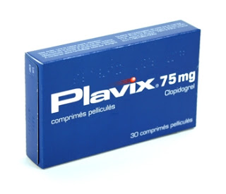
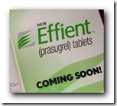
Clot Prevention - take for time 1 yr

Slide 15
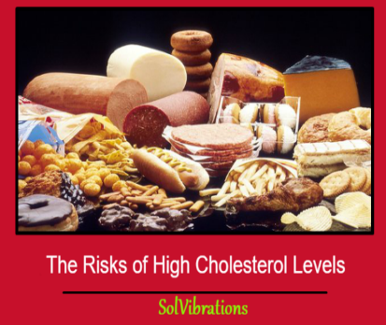
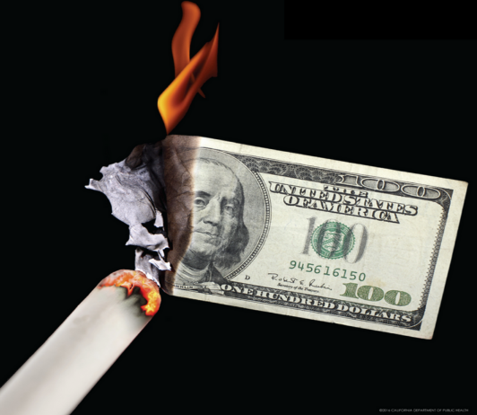
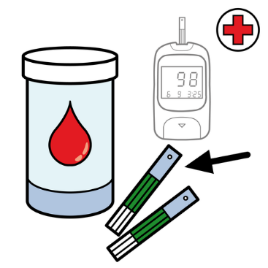
Coronary Artery Disease Risk Factors
Nonmodifiable
Gender
Age
Ethnicity
Family History
Modifiable
Obesity
Physical Inactivity
High Cholesterol
Hypertension
Tobacco use
Diabetes

Slide 16
What can I do to decrease my risk factors?
Address Obesity
1. Waist Circumference
Men <40 inches
Women <35 inches
2. Lifestyle changes: exercise & nutrition
3. Exercise at least 30 minutes 5 days a week
Increases HDL levels
Improve mood
Decrease blood pressure

Slide 17
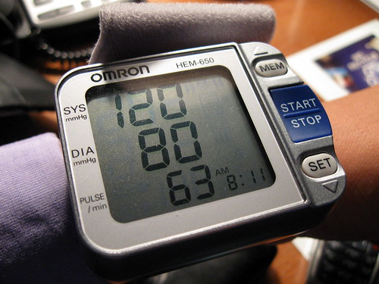
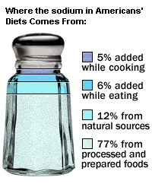
Risk Factors Continued…
Control high blood pressure
<120/80 less than
Manage stress and decrease salt intake
Exercise, nutrition
Medical management
Stop ALL tobacco use
Stop use as soon as possible
Avoid second hand smoke

Slide 18
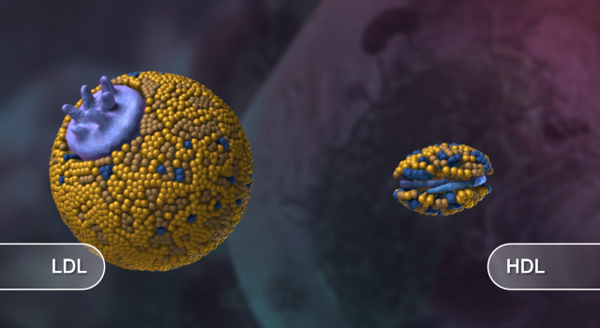
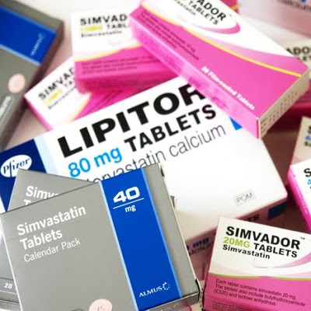
Risk Factors Continued…
Lower Cholesterol
Total cholesterol <200
LDL (bad cholesterol) <70 Triglycerides <150
HDL (good cholesterol)
Men >40
Women>50
Exercise
Nutrition
Cholesterol lowering medication

Slide 19
Coronary Artery Disease
Any Questions?

Slide 20
Cardiac Rehabilitation: Your Journey Back to Heart Health
Provided by CardioSmart and the American College of Cardiology
http://www.cardiosmart.org/cardiacrehab.aspx
Check out the website: www.cardiosmart.org

