Slide 15
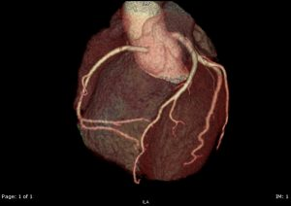
What is a CT Coronary Angiography (CTCA)?
CT Coronary Angiography, or CTCA is a special type of scan which uses CT scanning to take pictures of the coronary arteries of the beating heart.
These arteries supply blood to the heart muscles. Disease, narrowing or block in these vessels is respo
non invasive

Slide 18
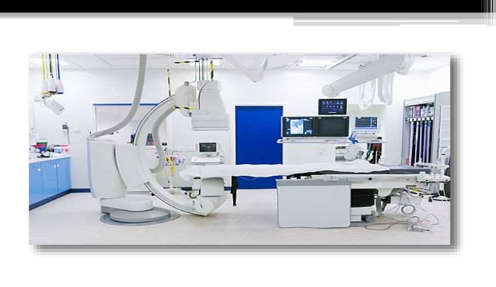

Slide 25
Questions?

