Slide 1
300,000 people have “SCA” Sudden Cardiac Arrest every year in the US
That is the most common cause of death for both men and women
(average age 64 and most die

Slide 2
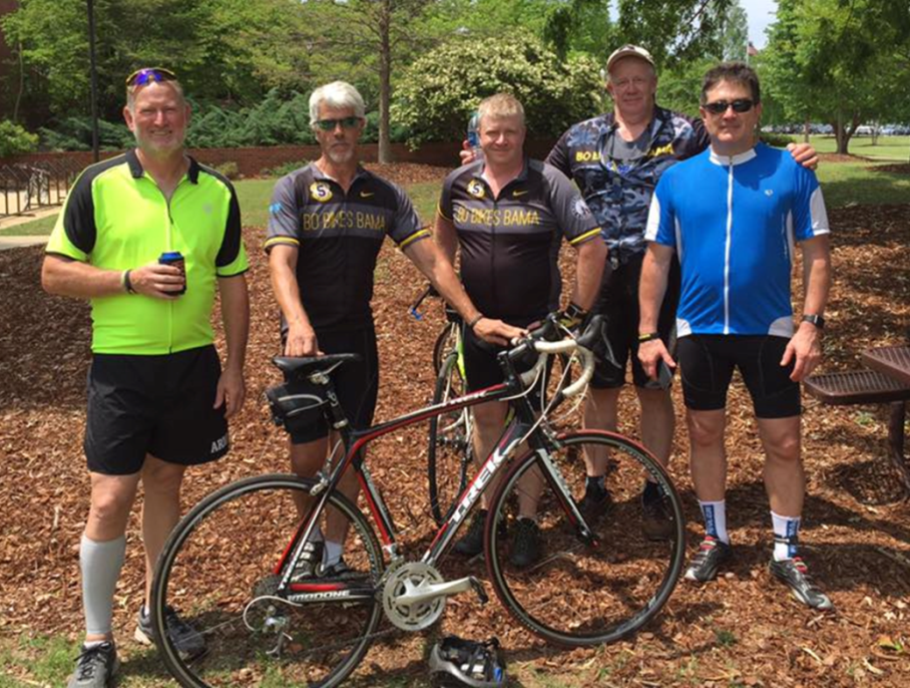
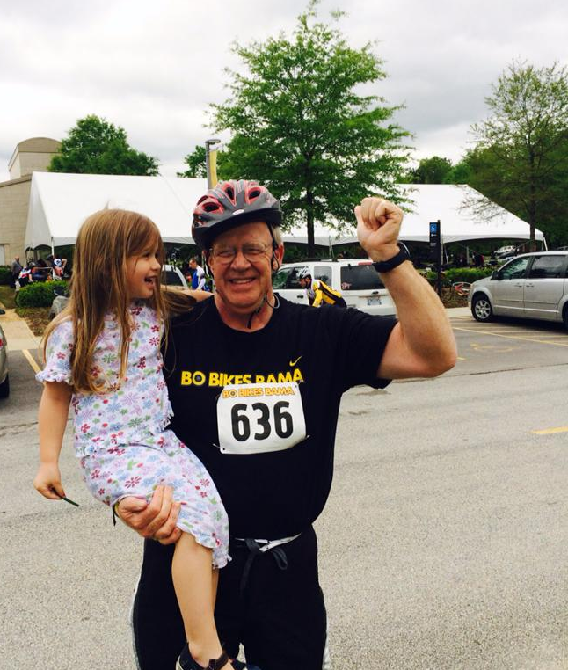
I am David Nordness and I though I was a healthy 64 year old. …. Not in great shape but no heart problems.
Charity Bike Ride
22 Miles
in May of 2016

Slide 3
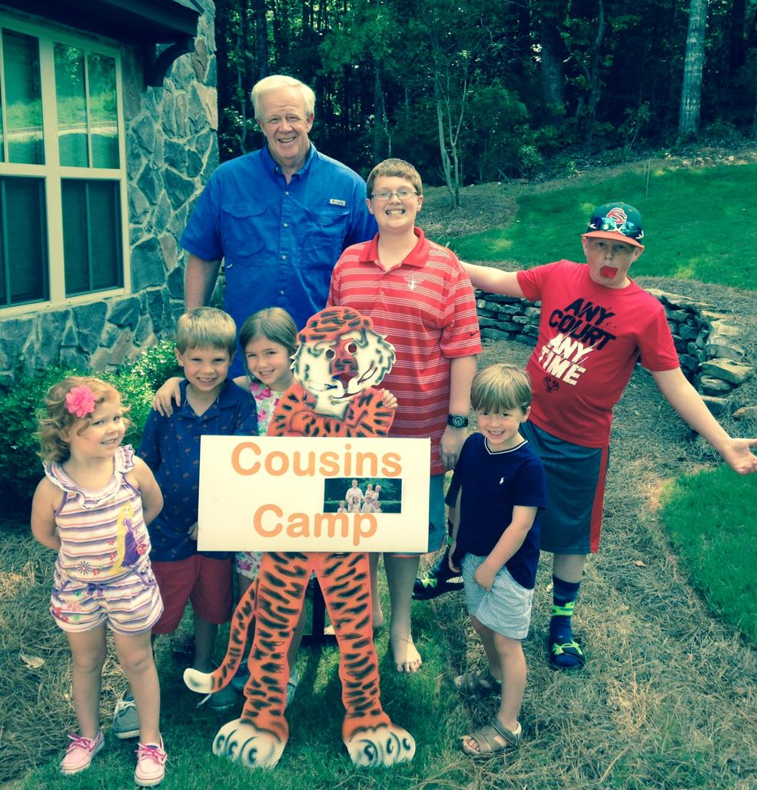
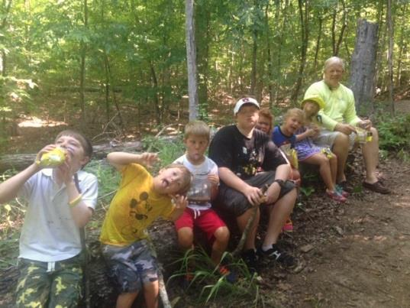
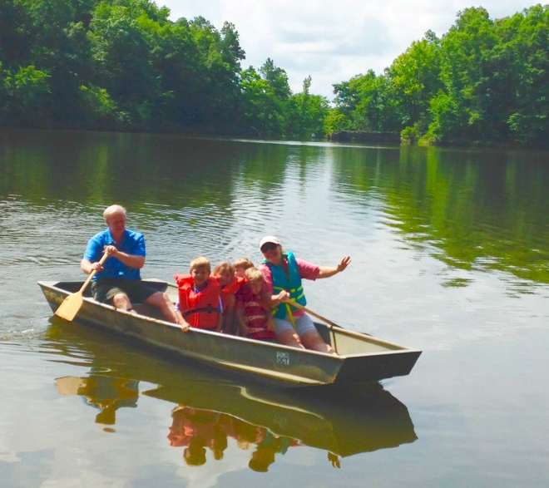
Summer
Cousin Camp - one month before
7 Days 7 Kids

Slide 4
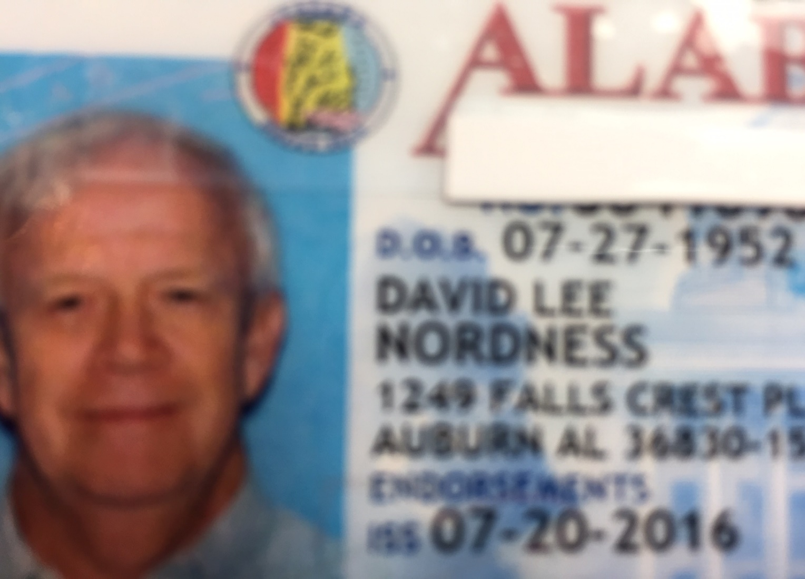
July 20, 2016 –Sudden Cardiac Arrest
-- Driver’s License picture 15 minutes before

Slide 5
Balloon Angioplasty of my widowmaker
before
after

Slide 6
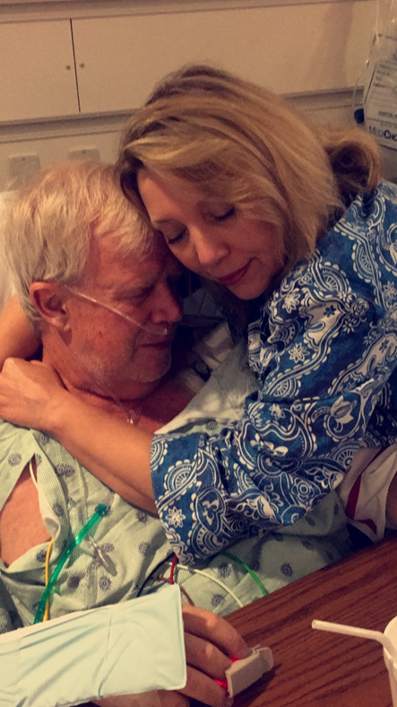
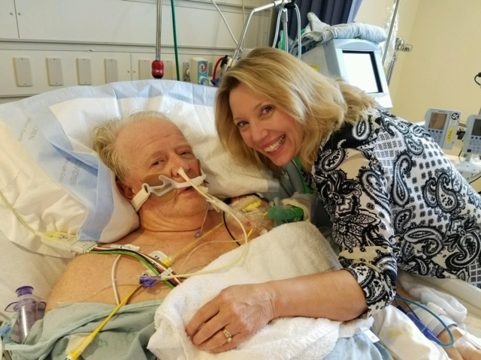
I am a very lucky man and can speak today
Because my wife acted quickly and did not quit!
Mary Martin Nordness, a ex lifeguard and past hospital trainer was driving the car that morning.
Notes:
On July 20th these two wonderful First Responders-Ben Perry and Carson Stroud -helped keep me alive until he made it to East Alabama Medical Center

Slide 7
Minutes count
She acted quickly, within minutes (10 MINUTES WITHOUT CPR IS FATAL)
Dragging her unconscious husband to a flat surface for CPR
Recruiting passers by to call 911 and a volunteer to help with Chest Compressions ( it is hard work and you will get tired. You cannot stop!)
Ambulance had an AED. (Defibrillator) but was never able to get a regular heart rhythm.
The EMTs maintained Chest Compressions during the ride to the Hospital
Ambulance communicated with EAMC Cardiac Unit. They were ready for me.
The EAMC discussed options and quickly used heart support and inserted stint to restore circulation.

Slide 8
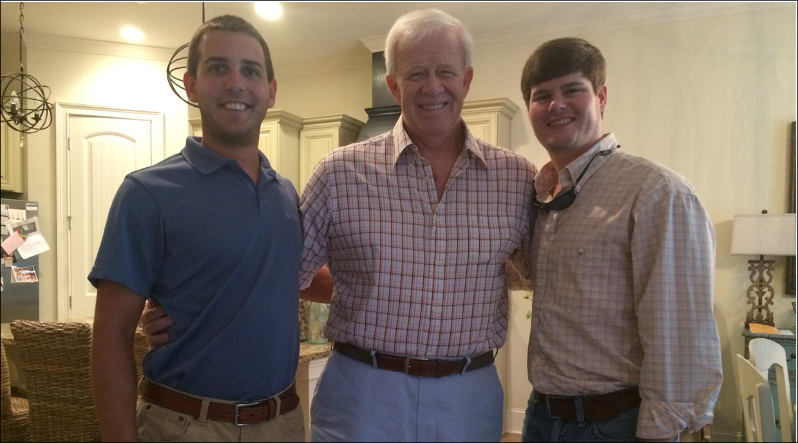
My Second Responders
Ben Perry and Carson Stroud
Notes:
On July 20th these two wonderful First Responders-Ben Perry and Carson Stroud -helped keep me alive until we made it to East Alabama Medical Center. Grateful for Ben and Carson and all the other First Responders (Auburn Police Dept, Auburn Fire Dept and Emergency Medical Services) and for Doug Martin who came to our rescue that hot day.

Slide 9
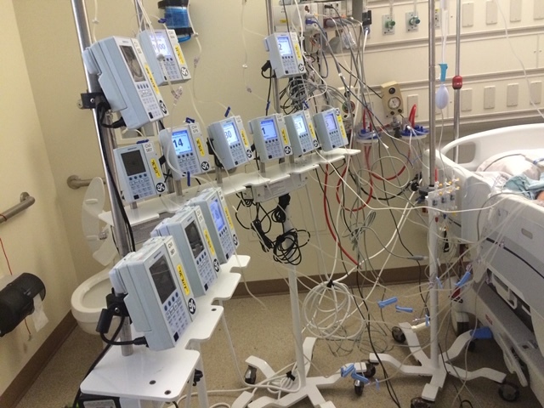
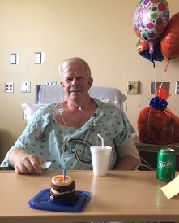
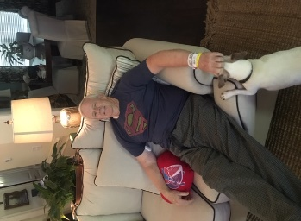
Monday July 18 | Tuesday | Wednesday | Thurs | Friday | Saturday | Sunday
Dr. Appt |  | July 20 SCA, Sudden Cardiac Arrest |  | Induced Coma
Awake July 25 |  | 64th Birthday
Aug 1 |  | 5 Cardiac Bypass |  |  | Hospital Discharge
 |  | Cardiac Rehab for 4 weeks |  |  | Return to work in 6 weeks

Slide 10
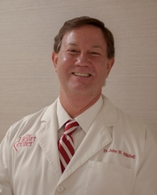
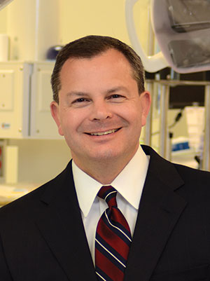
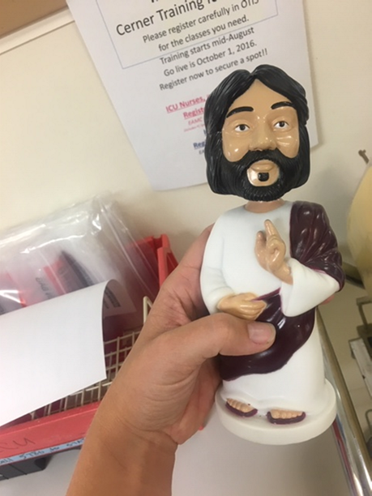
Dr. John Mitchell Cardiologist
My Medical Team
Dr. Barry Crowe
Cardiothoracic Surgeon
Bobblehead Jesus from Nursing staff

Slide 11
“Mary?”
“Katie”*
They knew I was thinking.
I was unconscious during GOP convention.
*causing much contention in the waiting room among daughters

Slide 12
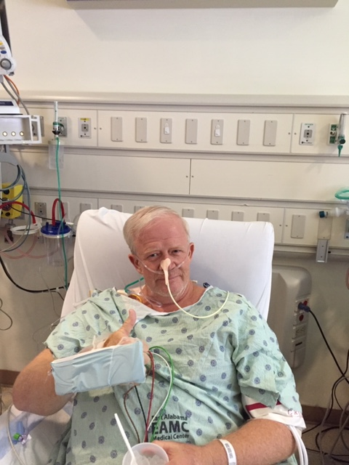
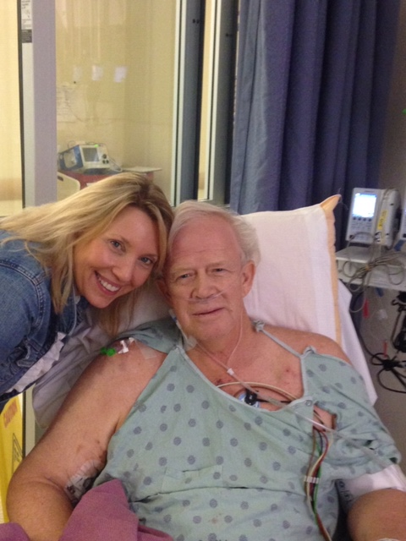
I am more serious about exercise, 3 or 4 times a week
Worked 2 more years. Staying active, with a positive attitude.
I watch what I eat, lost a little weight.
My brothers got checked for heart problems, two of the four did.
Working with Mended Hearts a Cardiac Peer Support group
Even more thankful for my family and friends.
Bought a secondhand AED to educate and maybe save someone's life.
Notes:
19 days in the hospital, 5 bypasses and countless prayers

Slide 13
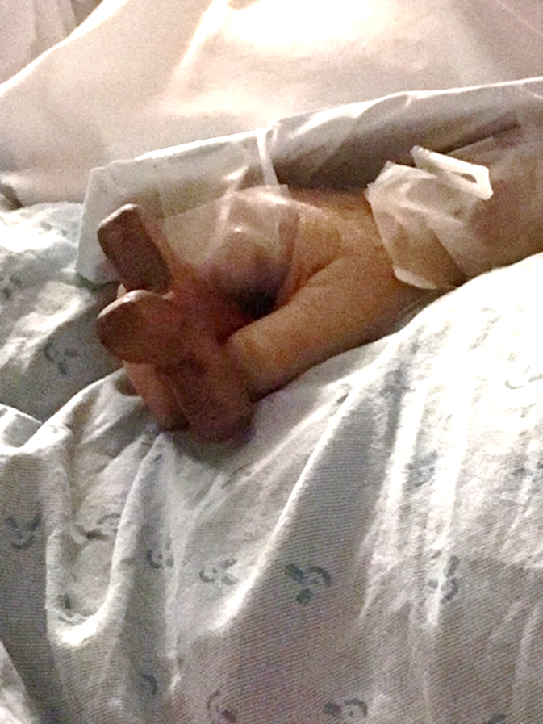
"Now when David had served God's purpose in his own generation, he fell asleep; he was buried with his ancestors…”
This was the verse shared in the sermon when my daughters went to church in while I was unconscious in the Hospital.
At first it terrified them until they had the revelation that their “David” had not yet served your purpose in your generation!!!

